Slide 1

Come – Everything is Ready!
World Day of Prayer 2019
Prepared by WDP Slovenia

Slide 2
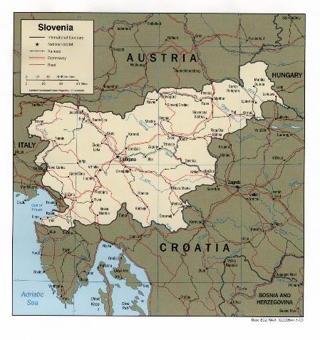
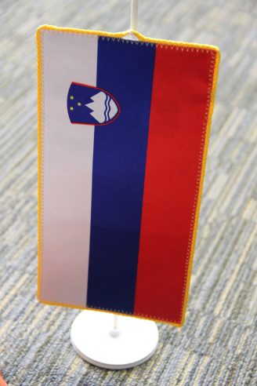
1. Geography & Population
©Tanja Povšnar

Slide 3
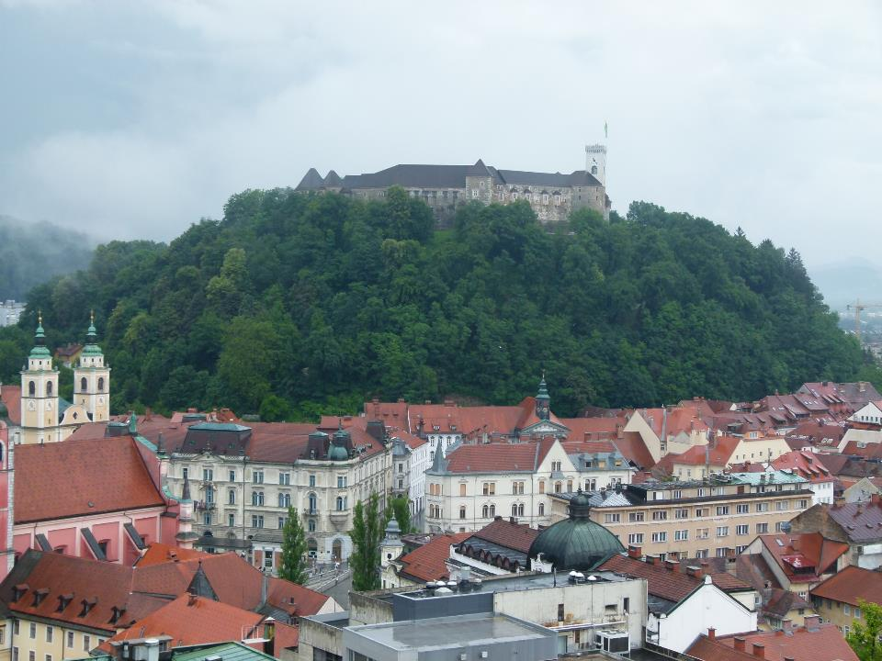
The Capital - Ljubljana
©Gaby Drewes

Slide 4
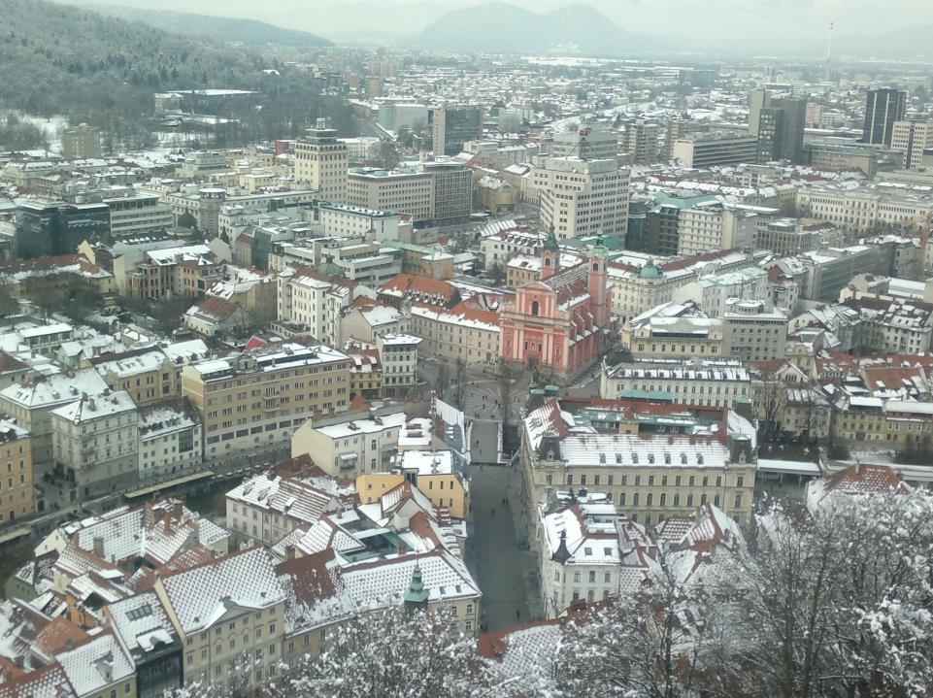
The Capital, Ljubljana
©Lijana Petek

Slide 5
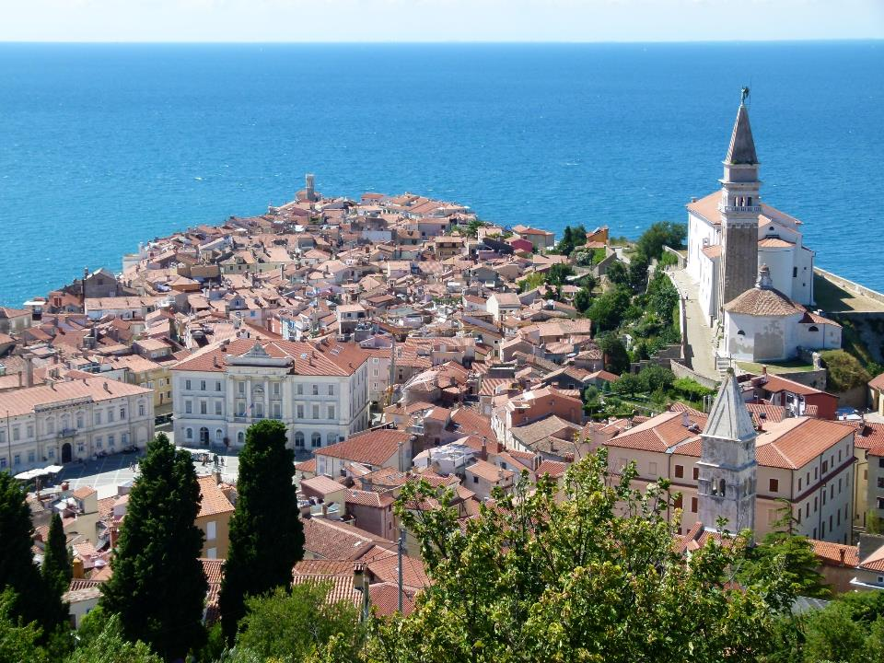
Town of Piran
©Gaby Drewes

Slide 6
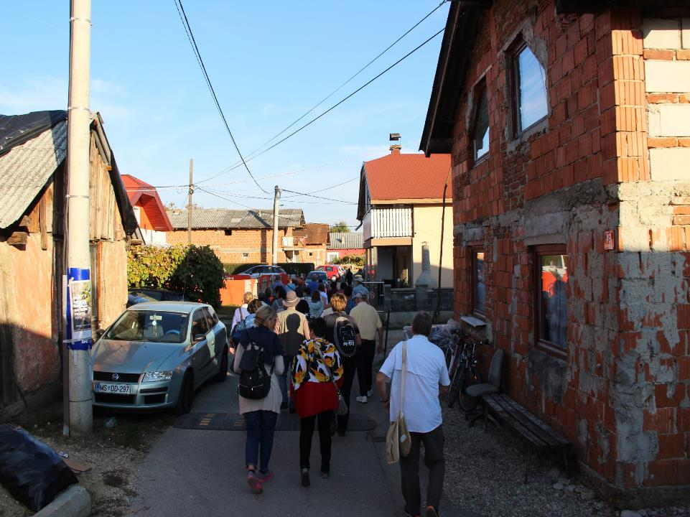
Pušča - Roma Village
©Tanja Povšnar

Slide 7
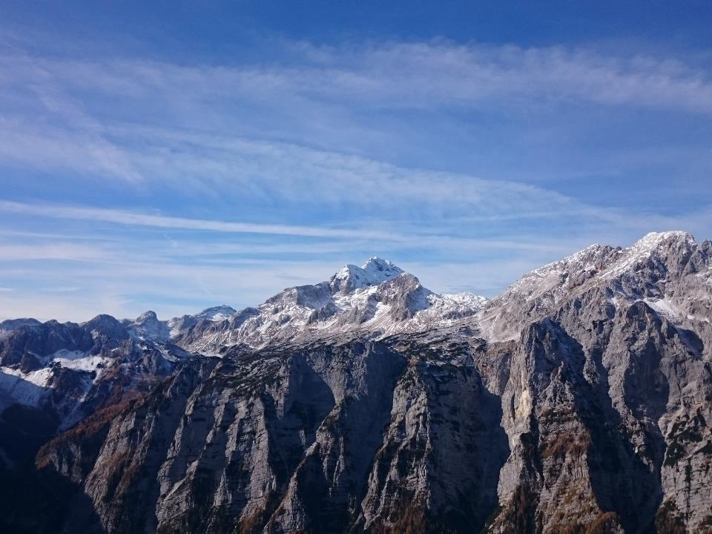
Mount Triglav
©Ana Petek Bahar

Slide 8
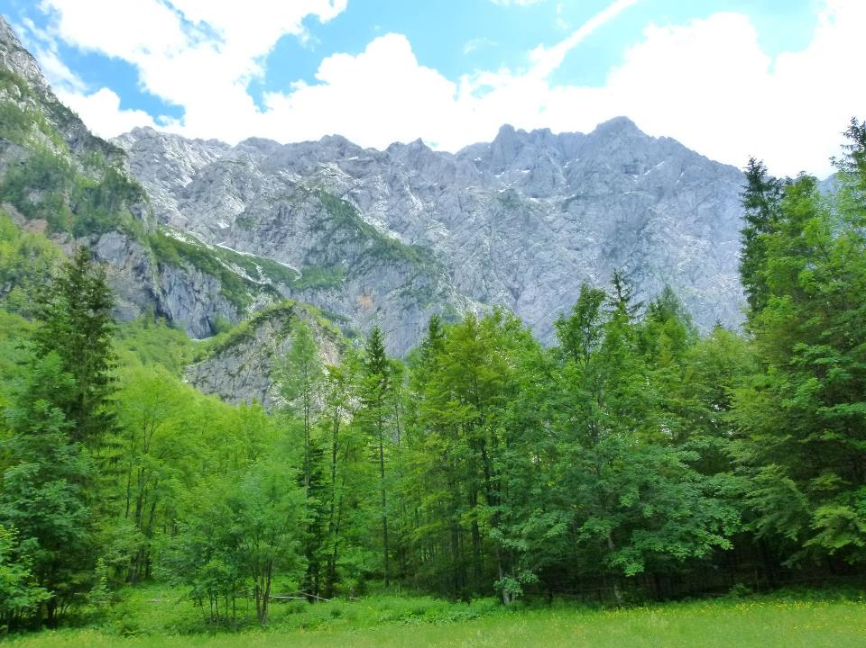
©Gaby Drewes

Slide 9
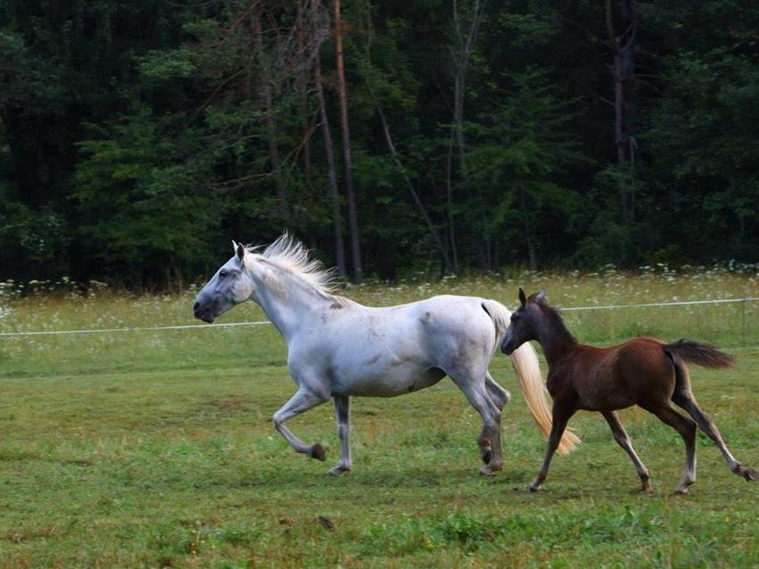
Lipizzaners
©Branko Petauer

Slide 10
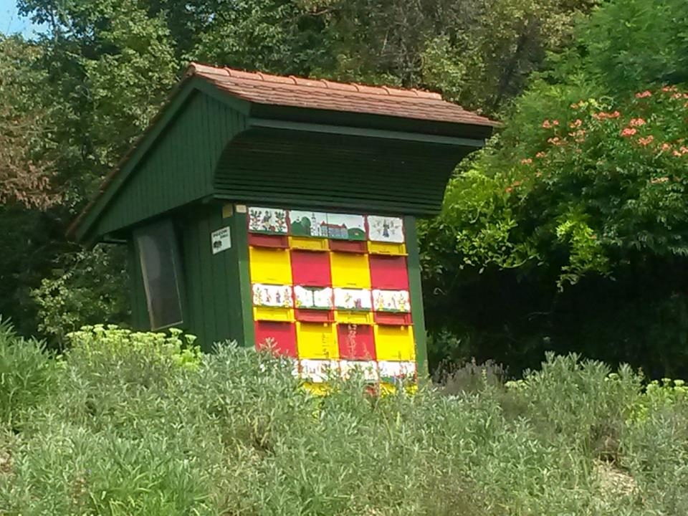
©Lijana Petek

Slide 11
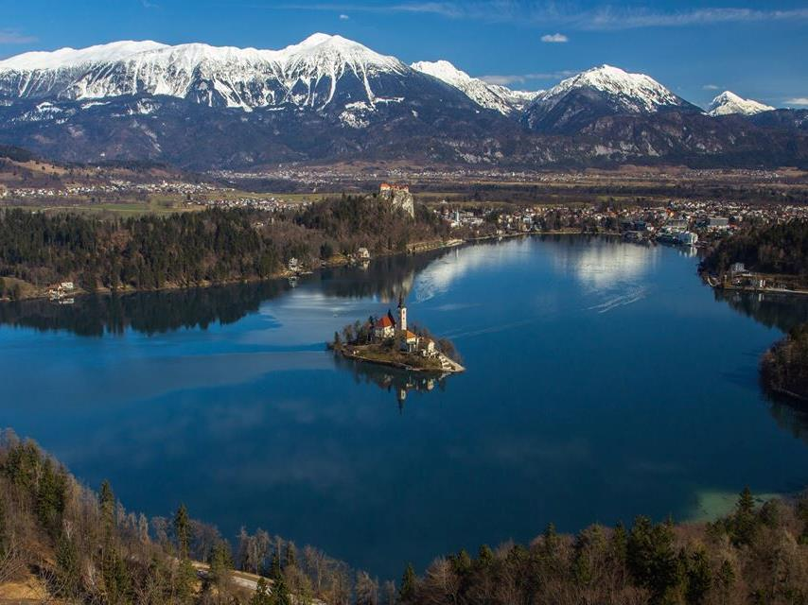
Bled Lake
©Miro Zalokar

Slide 12
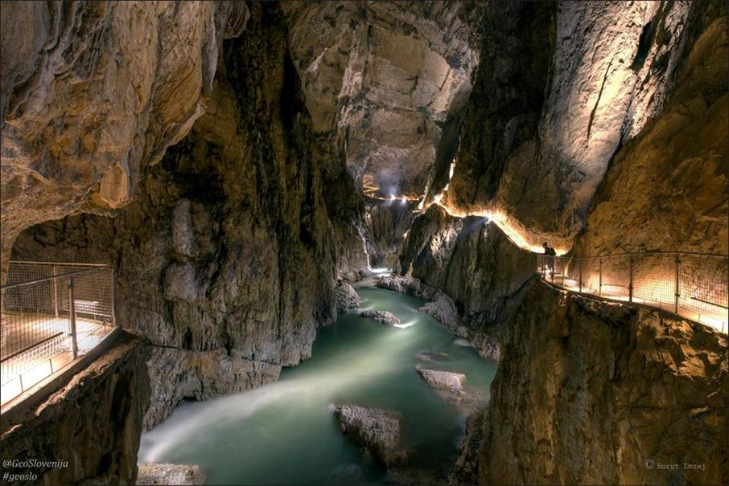
Park Škocjanske Jame
©Borut Lozej

Slide 13
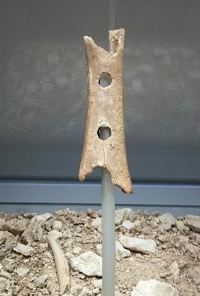
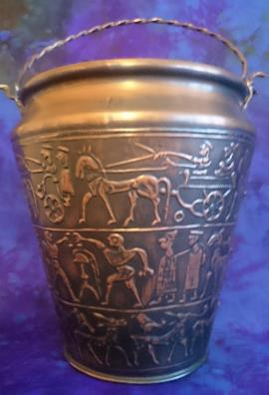
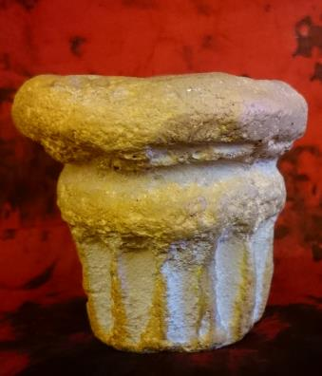

2. Political History
©Lijana Petek
©Lijana Petek
Neanderthal flute,
Paleolithic Period
Vače situla, 5th c. BC,
found at Hallstatt Archaeological Site in Vače
The Prince’s Rock,
symbol of Carantania

Slide 14
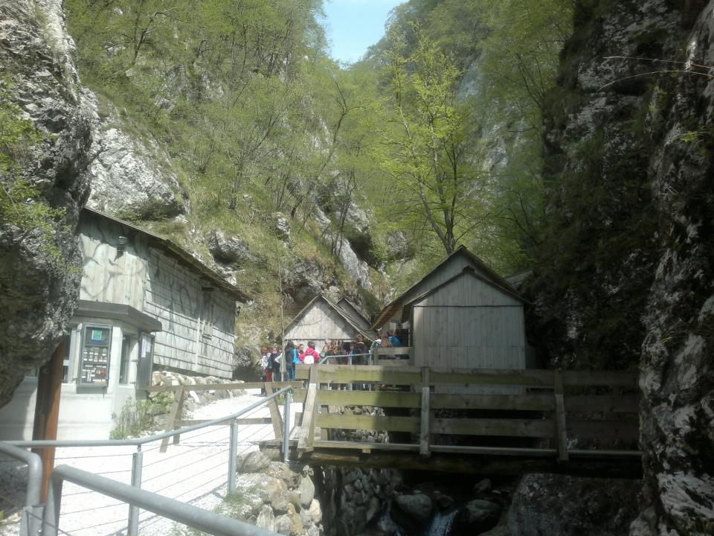
Partisans hospital, Franje
©Lijana Petek

Slide 15
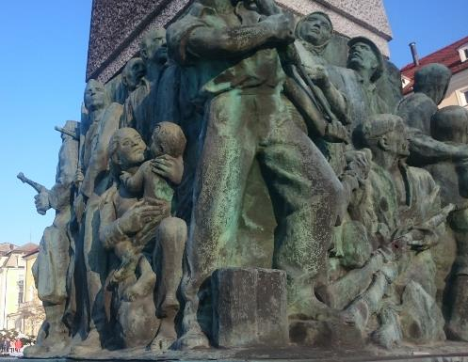
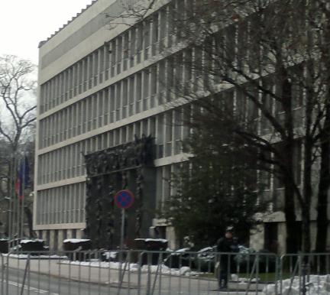
Nation Liberation Monument, WWII
Parliament
©Lijana Petek

Slide 16
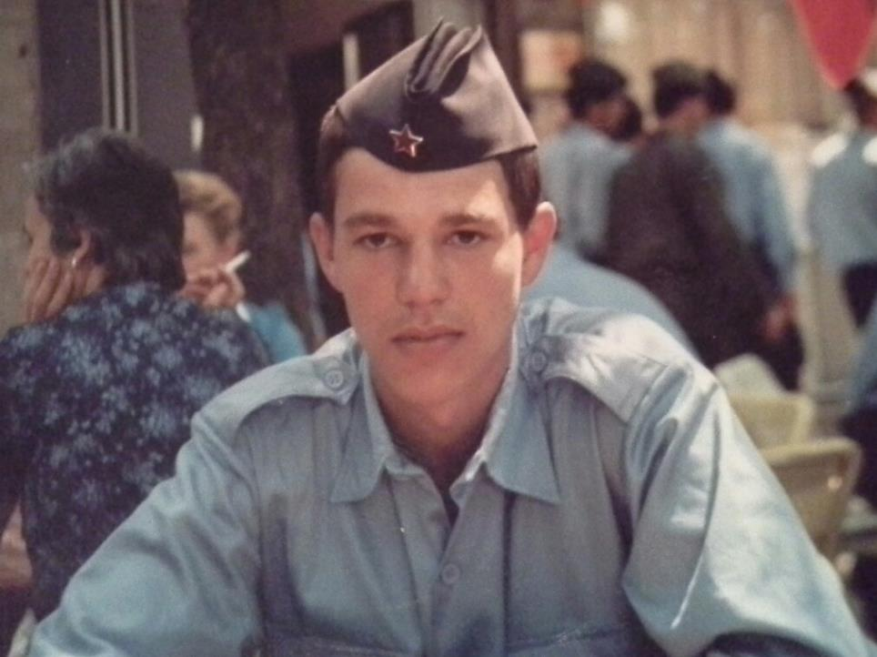
SFRY Army Solider
©Tanja Povšnar and Dušan Vrečar

Slide 17
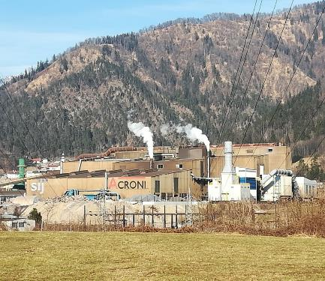
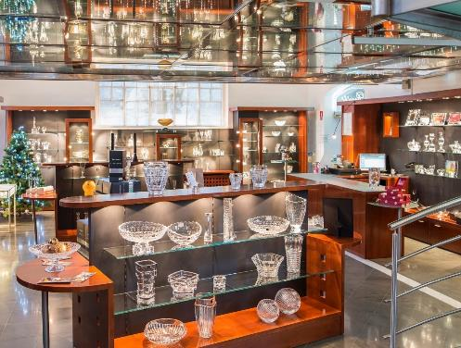
3. Economy
Stainless Steel Industry
Crystal Factory
©Lijana Petek

Slide 18
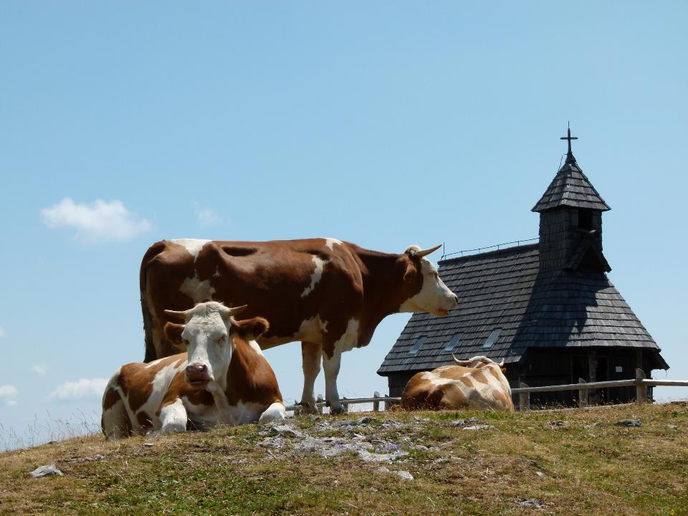
©Gaby Drewes

Slide 19
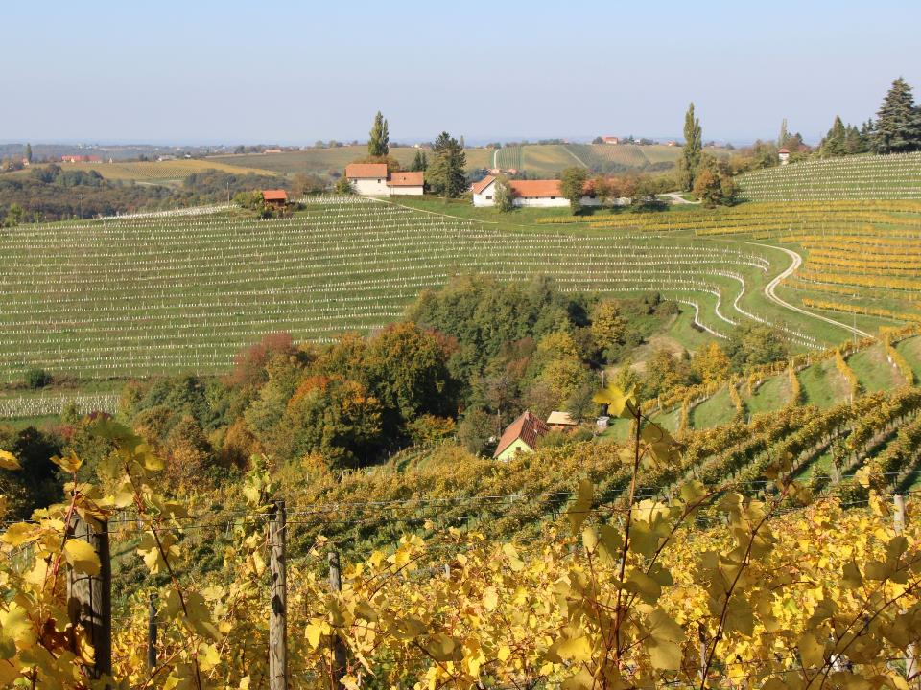
©Tanja Povšnar

Slide 20
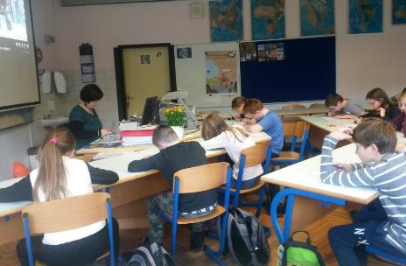
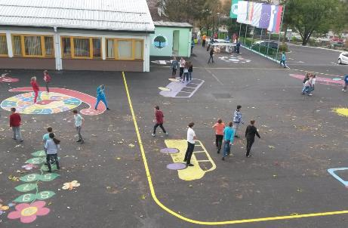
4. Education
©Lijana Petek

Slide 21
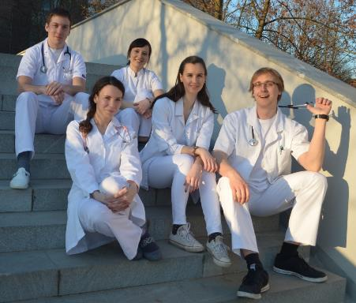
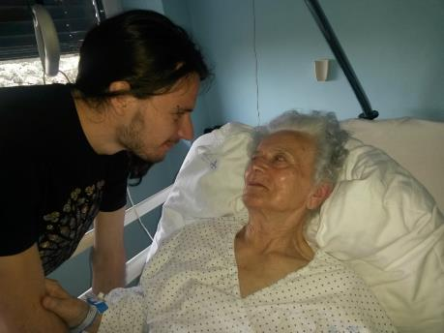
5. Health Care
©Lijana Petek
©Ana Petek Bahar

Slide 22
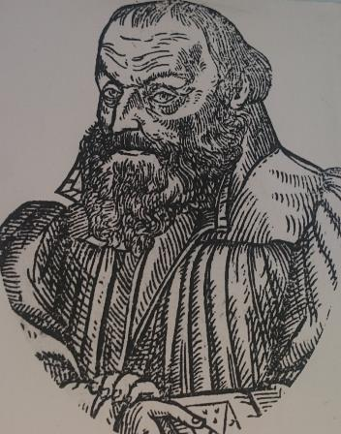
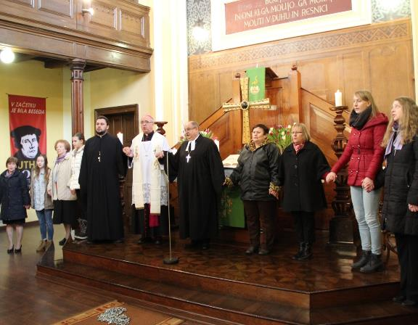
6. Religion
©Lijana Petek
©Tanja Povšnar
Primož Trubar
Lutheran Church

Slide 23
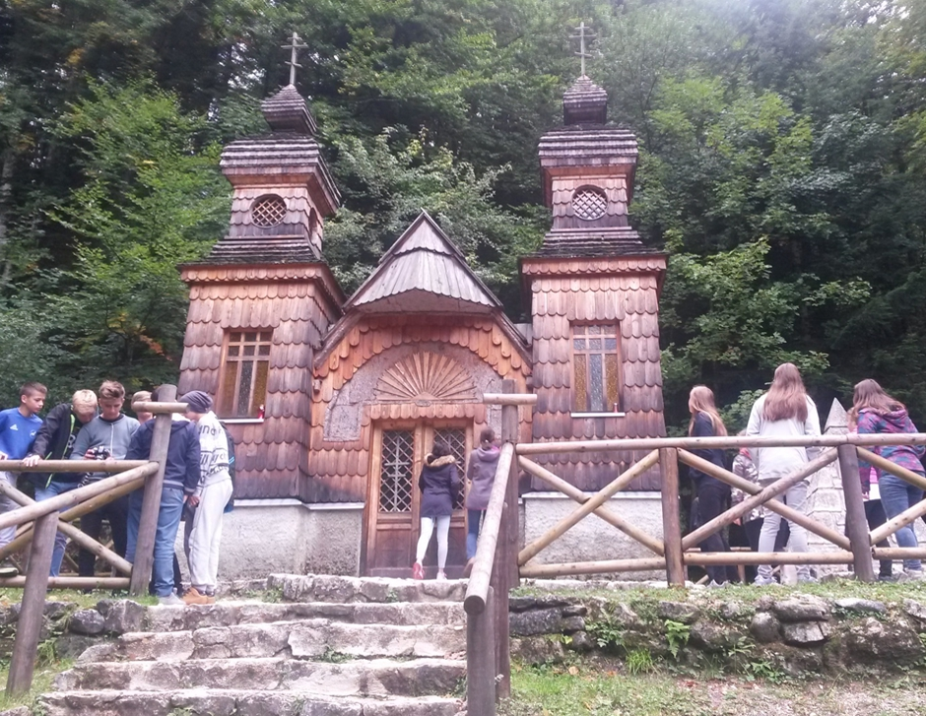
Russian Orthodox Chapel in Triglav National Park
©Lijana Petek

Slide 24
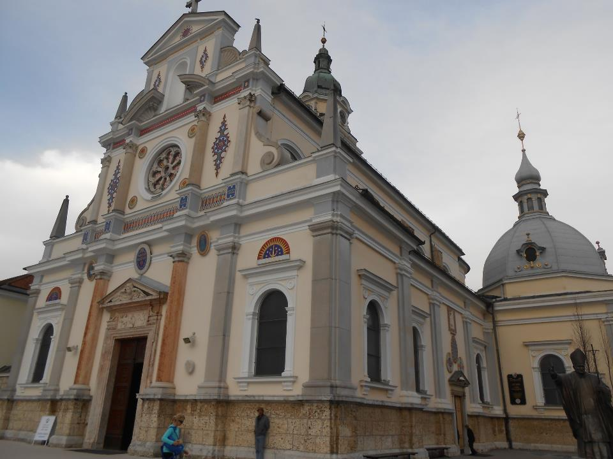
Catholic Church
©WDPIC

Slide 25
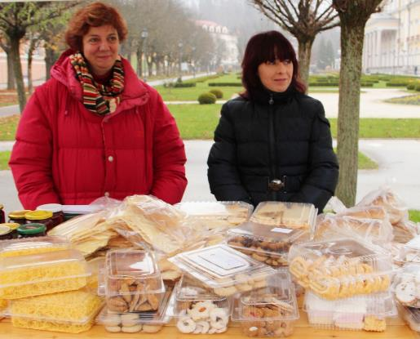
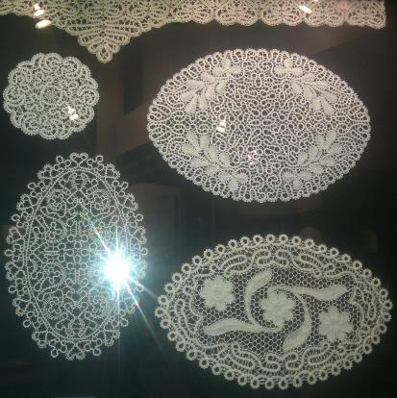
7. Women’s Life
Bazar
Idrijan lace
©Lijana Petek

Slide 26
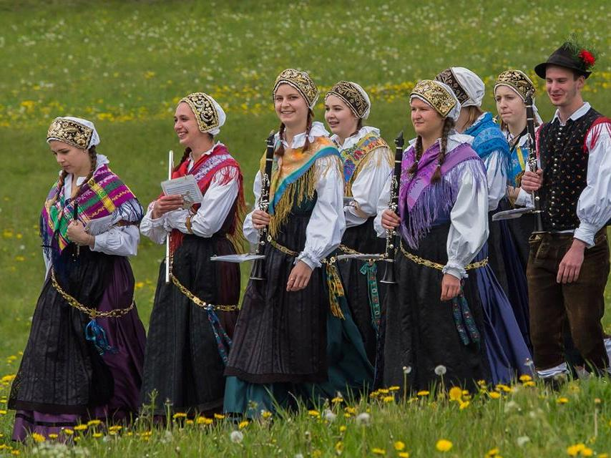
©Miro Zalokar

Slide 27
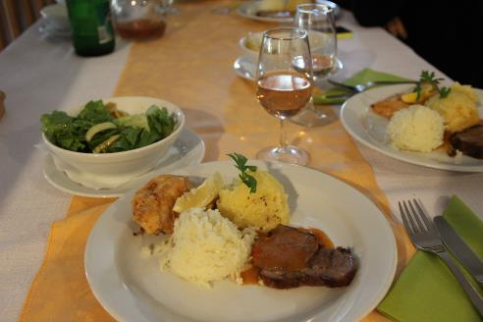
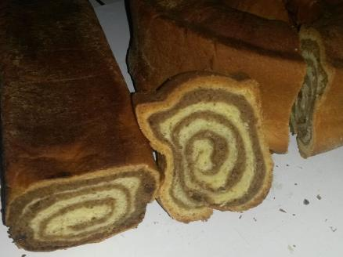
8. Cuisine
©Tanja Povšnar
©Ana Petek Bahar
Typical lunch
Walnut potica

Slide 28
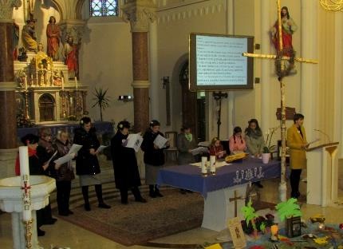
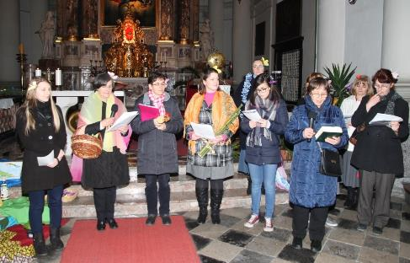
9. World Day of Prayer in Slovenia
©Lijana Petek
©Tanja Povšnar
WDP Service in Rogaška Slatina
WDP Service in Ljubljana

Slide 29
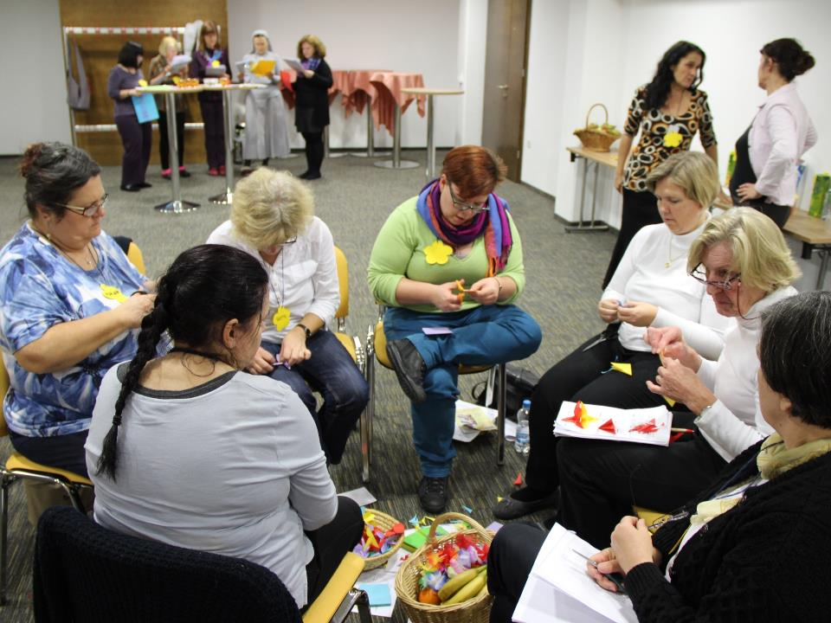
©Tanja Povšnar

Slide 30
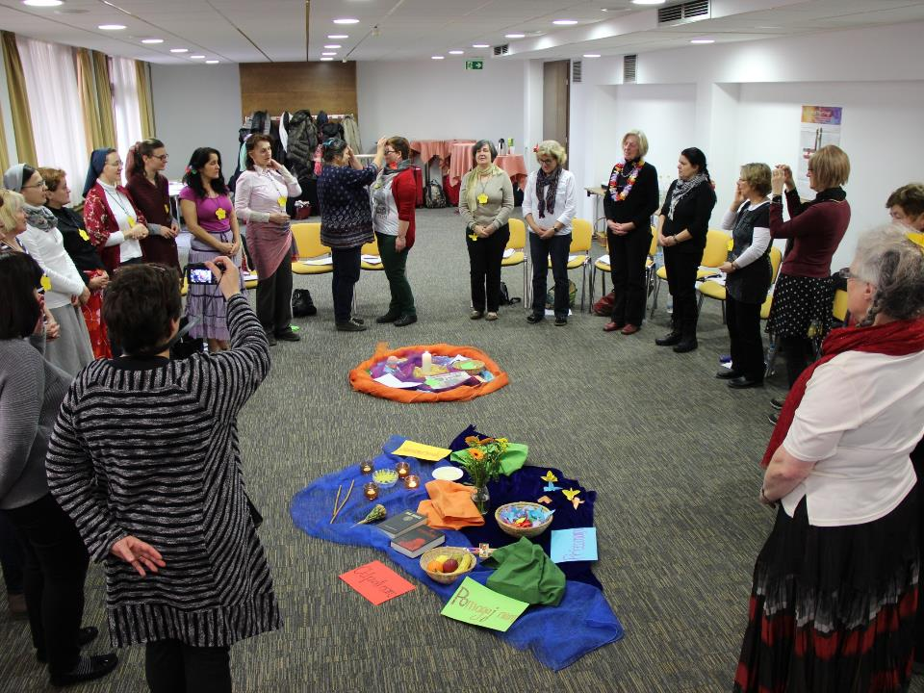


Slide 31
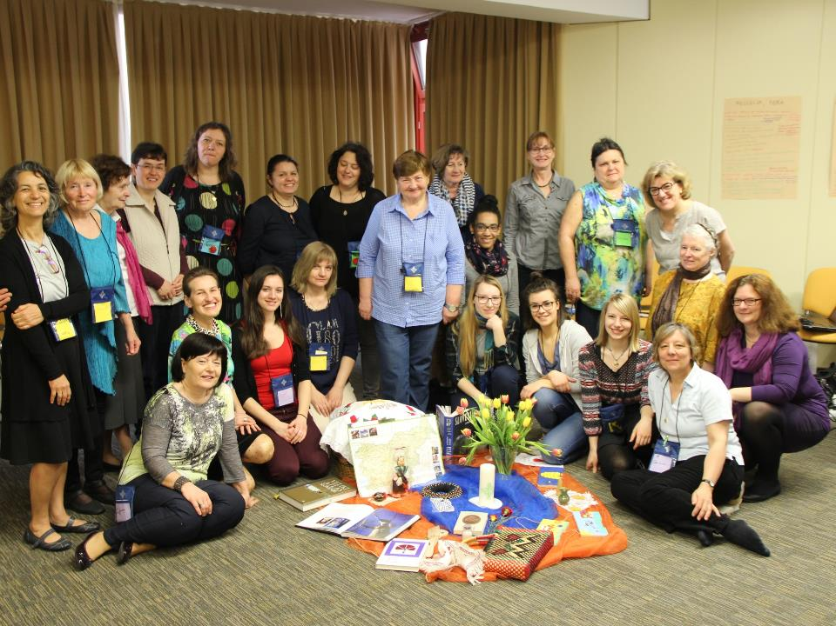

Slide 32
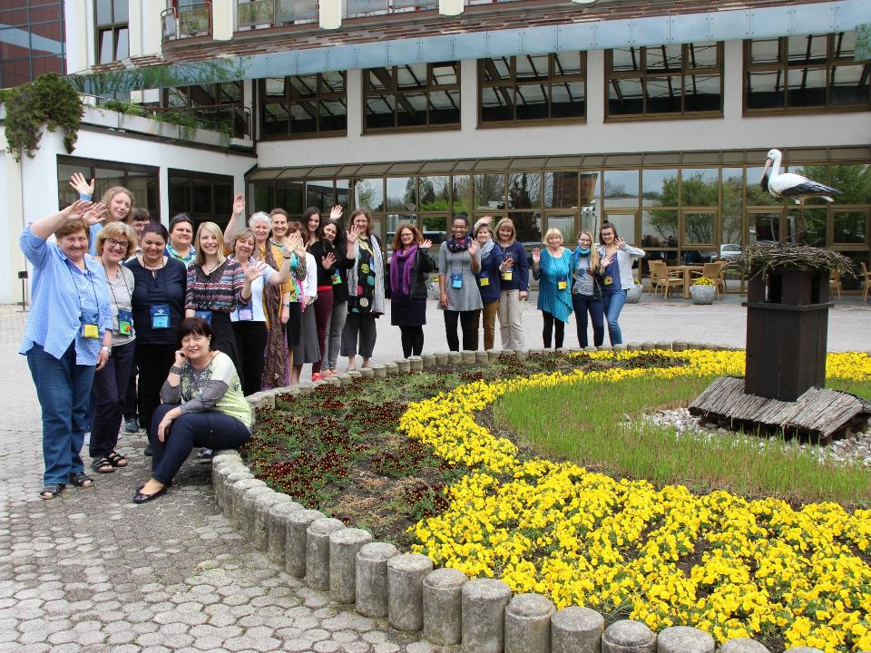

Slide 33
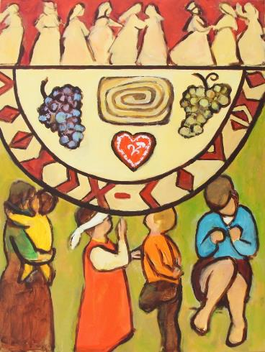
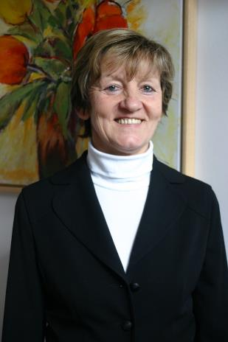
10. Artist & Artwork
©Branko Arnuš
©Janez Strah
Rezka Arnuš

