Slide 1
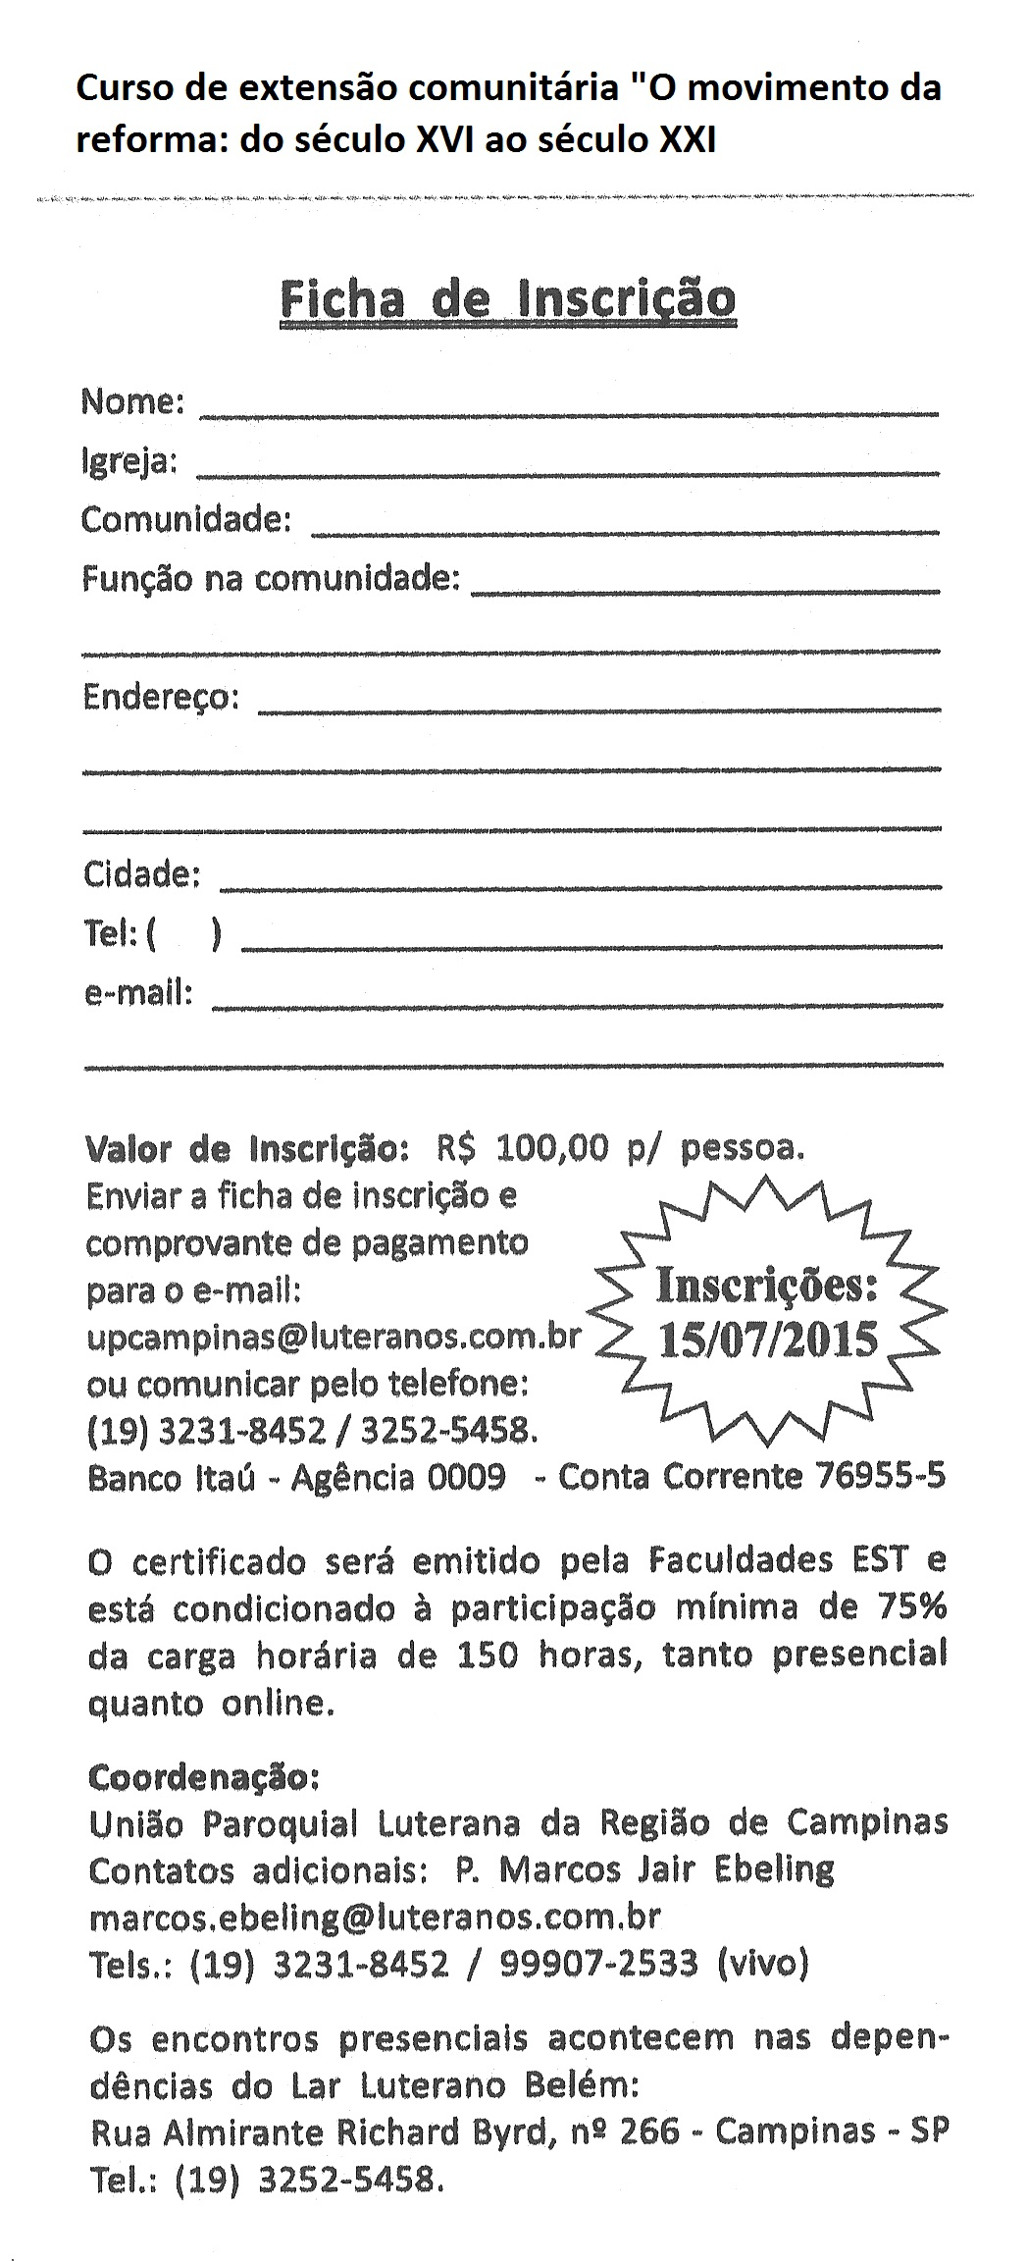
xxxxxx
xxxxxxx
xxxxx
xxxxxxx
xxxxxxxx
xxxxxxxx
xxxxxxxx
xxxxxxxxx
xxxxxxxx
xxxxxxxxx

